Slide 1

Exploratory Data Analysis of Unicorn Companies Around the World
Python for Data Analytics Project APRIL DAF 2023
By
Solomon Onu Audu

Slide 2

Contents
Overview of Unicorn Companies Across the world
Concentration of Unicorn Growth Across the World
Global Trends in Unicorn Investments And Growth
Growth Recommendations For Unicorns

Slide 3
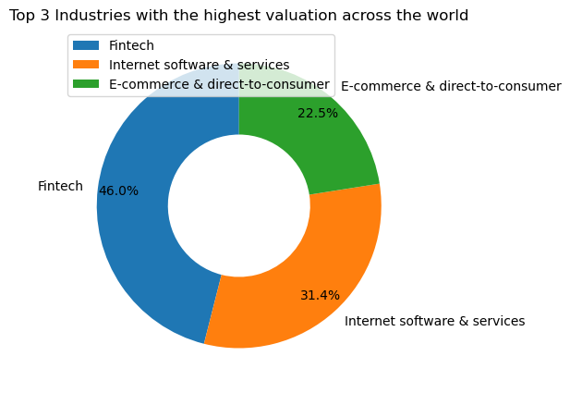
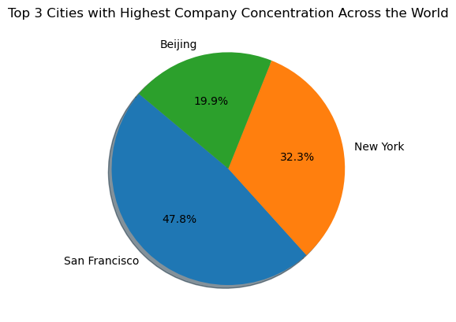
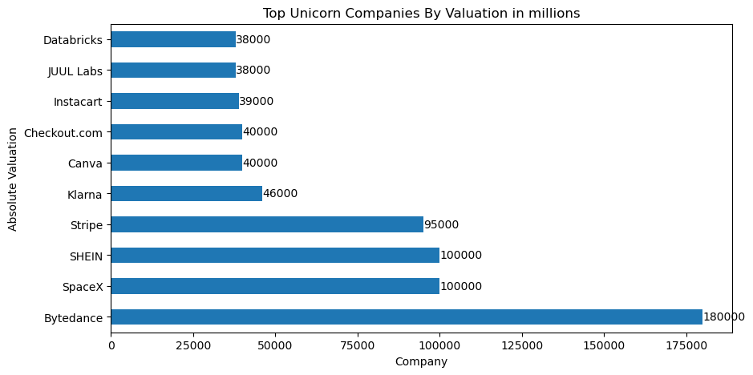
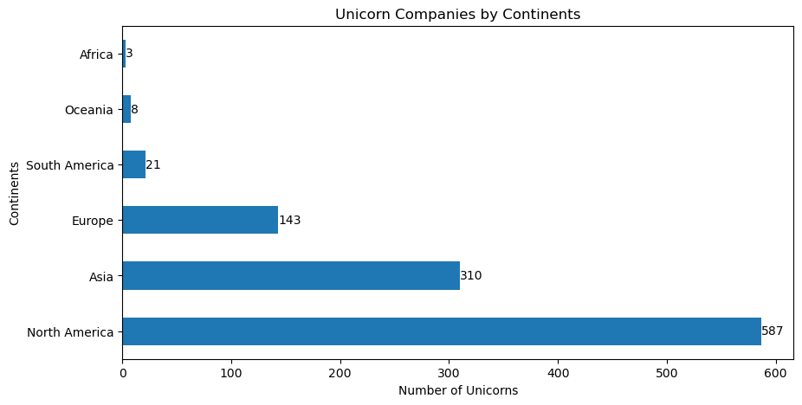
Overview of Unicorn Companies Across the World
Key Observations
The Fintech Industry has Unicorn Companies with highest valuation across the world with 46% of Unicorns having high valuation.
Internet software and service industries have the second largest number of Unicorns with high valuation of 31.4%, followed by E-commerce and direct-to-consumer industries with 22.5%.
The highest concentration of Unicorn Companies were in the City of San Francisco and New York both in the USA, with 47.8% and 32.3% respectively, making these cities industrial hub for Unicorn Companies.
Beijing in China has a Unicorn Concentration of 19.9%, making it the third city with high concentration of Unicorns.
Bytedance, in China is the most valued Unicorn company with a valuation of $180 billion, followed by SHEIN, another Unicorn in China with a valuation of $100 billion and SpaceX, an American Company, also with a valuation of USD100 billion
North America, Asia, and Europe have more Unicorns than the rest of the world combined.
South America, Oceania and Africa have the least number of Unicorns.

Slide 4
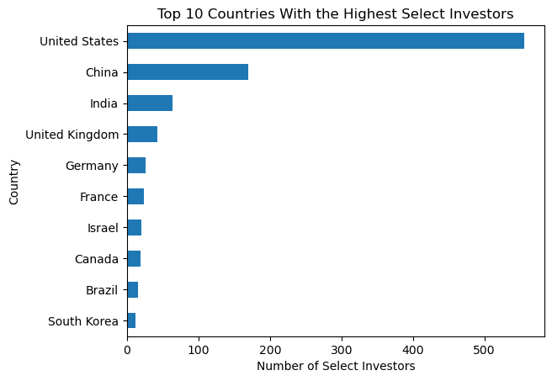
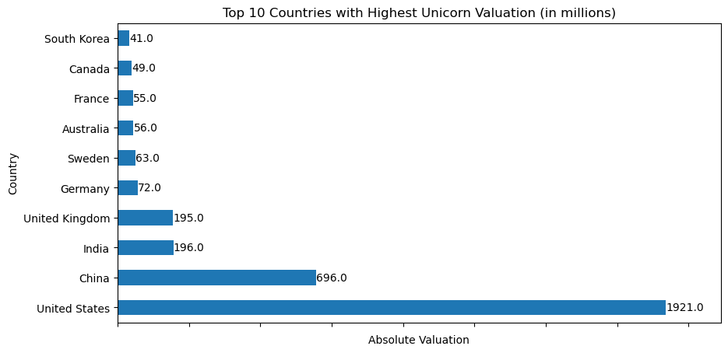
Concentration of Unicorn Growth Across the World
Key Observations
The USA and China have more select investors for Unicorn Companies with 556 and 170 respectively.
Other Countries in the top 10 with highest Select investors are India, UK, Germany, France, Israel, Canada, Brazil and south Korea with a combined number of 224 Select investors.
The USA has the highest number of Unicorns by valuation, with $1.921 trillion, while China, India, UK and Germany has a combined valuation of $1.12 trillion.
Other Countries such as Sweden, Australia, France, Canada and South Korea, also have high concentration of Unicorns with a combined valuation of $264 billion.

Slide 5

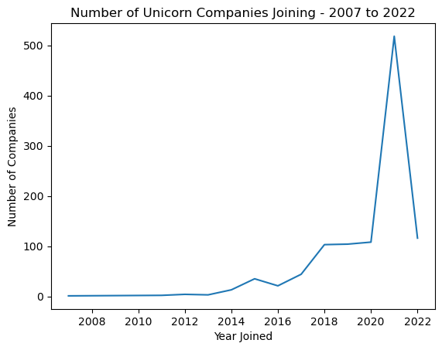
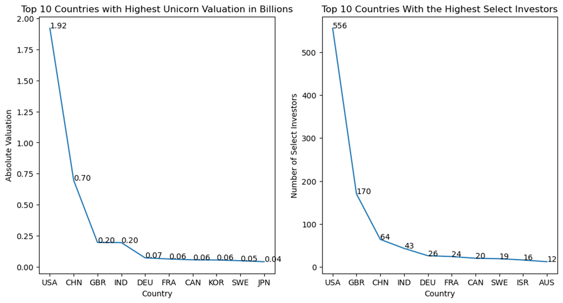
Global Trends in Unicorn Investments And Growth
Key Observations
The number of Unicorn Companies gradually increased from 2007 to 2017 from 1 in 2007 to 44 in 2017.
There was a sharp increase in the number of Unicorns between 2018 and 2022, with 103 companies becoming Unicorns in 2018 and 518 Companies becoming unicorns in 2021,
The top 10 Countries with highest number of select investors also produced the Unicorns with high valuations.
The funding support by Select investors play a significant role in the growth and expansion of Unicorn Companies across the world.
There is a direct relationship between high funding by Select Investors in Unicorn Companies and the total number of Unicorns Companies a Country have.
The higher the number of Select investors in a Country, the higher the number of Unicorn Companies from that Country.

Slide 6

Growth Recommendations for Unicorns Companies
Access Venture Capital funds when needed
Unicorn companies in Africa, Oceania and South America should endeavour to approach venture capitals to negotiate how they can raise funds to scale their business. USA has over 500 Select investors supporting growth of Unicorns.
Network with Unicorn Companies in Countries with high numbers of Select investors to sell their business to potential investors.
Establishment of a growth culture within the business
Develop and share future revenue and staffing objectives and projections to internal stakeholders
Employ experienced employees with relevant skills and capabilities to meet current and future business needs.
Ensure effective communication between all levels of management and eliminate office politics, prejudice and bias.
Create and provide training and advancement opportunities for staff in order to drive retention.
Leverage Emerging Technology
Artificial Intelligence and Machine learning can help companies to improve their systems and processes. 46% of
Unicorns are in Fintech and 31.4% are in Internet Software and Services.
Focus on creating the right strategic objectives per time
- Growing customer base into new markets to increase revenue streams. There are more Unicorns in 2020 and 2022.
Investing more in research and developments to innovate and improve operational efficiency
networking and forming partnerships with other Unicorns. 47.8% of Unicorns are in San Francisco, 32.3% in New York, and 19.9% in Beijing. Other Unicorns can reach out to them for best practices on growth strategies.

Slide 7


Conclusion
Unicorn Company,
Build the next one.

